Slide 1
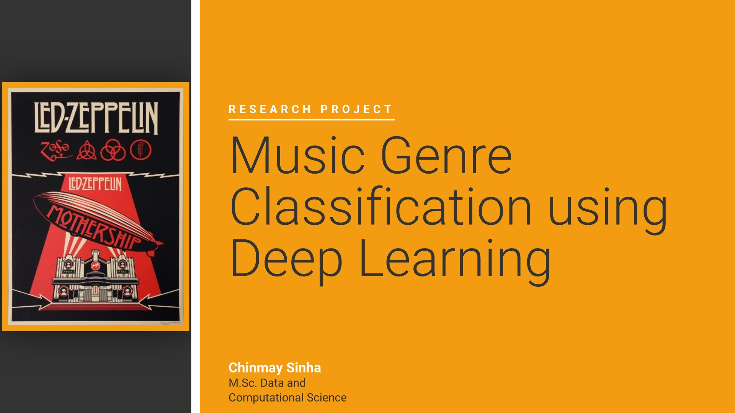


Credit:
Dr. Isabella Gollini, UCD

Slide 2
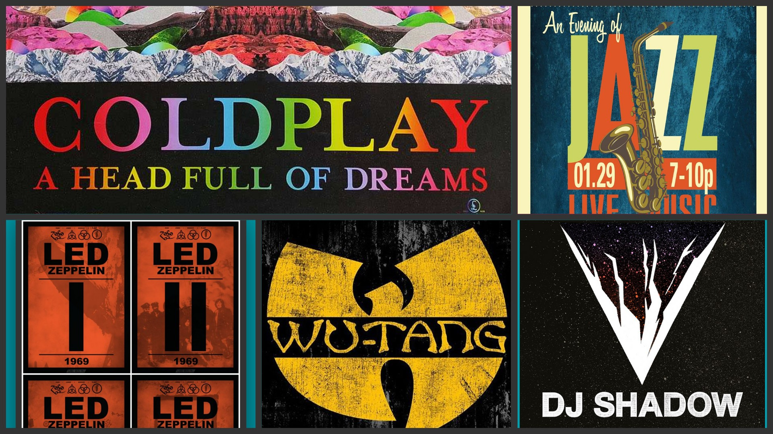
POP
JAZZ
HIP - HOP
ROCK
ELECTRONIC

Slide 3


Slide 4
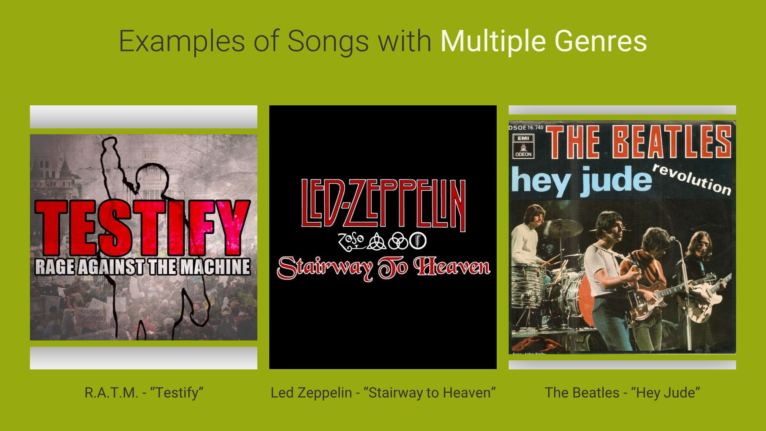
HIP-HOP - 40%
METAL - 60%
COUNTRY - 30%
POP - 40%
BLUES - 30%
BLUES - 30%
ROCK - 70%

Slide 5
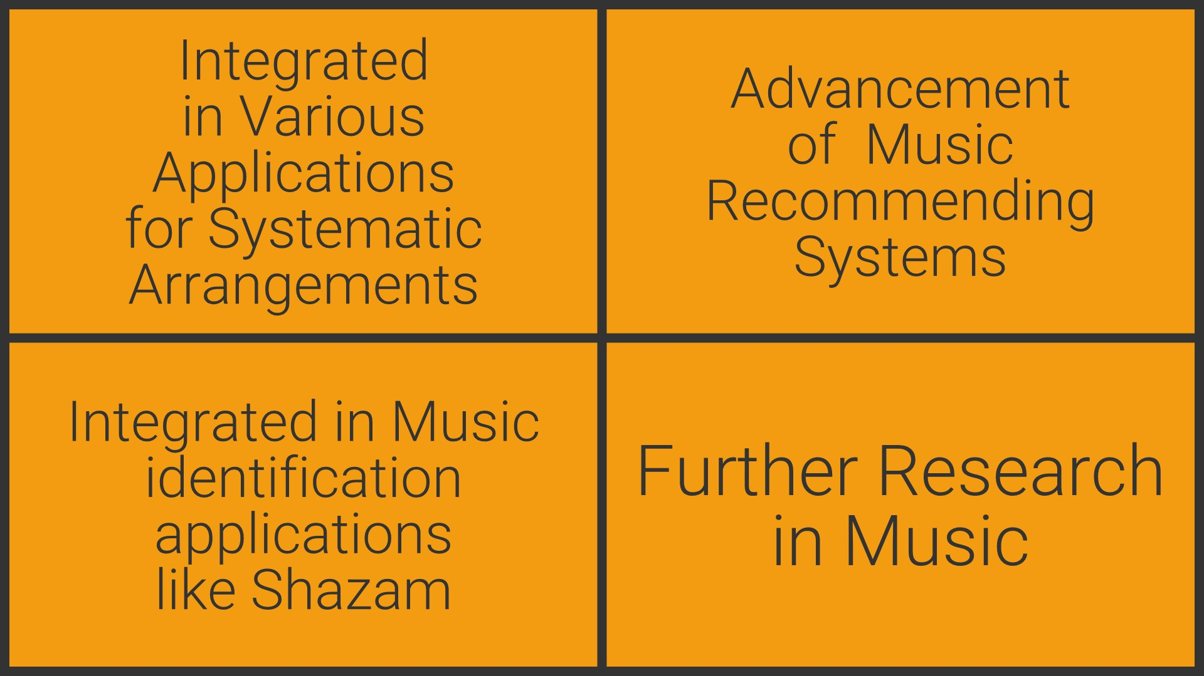




Slide 6
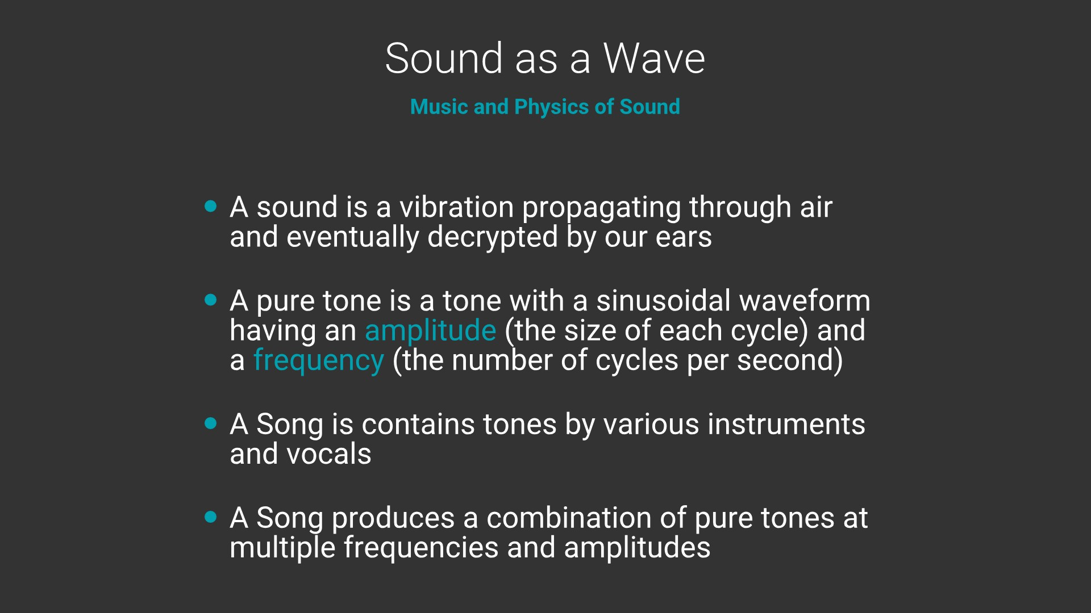


Slide 7
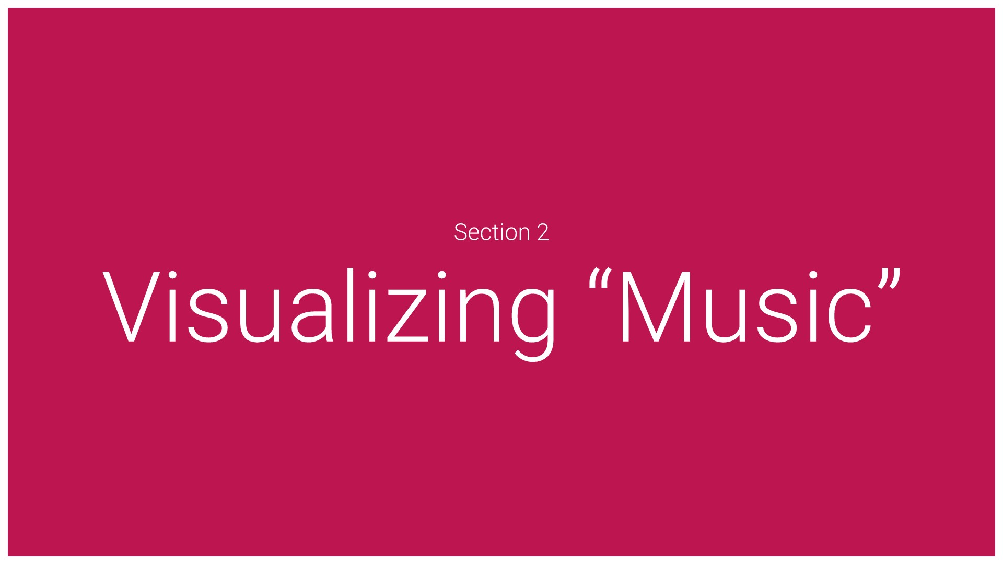

Slide 8
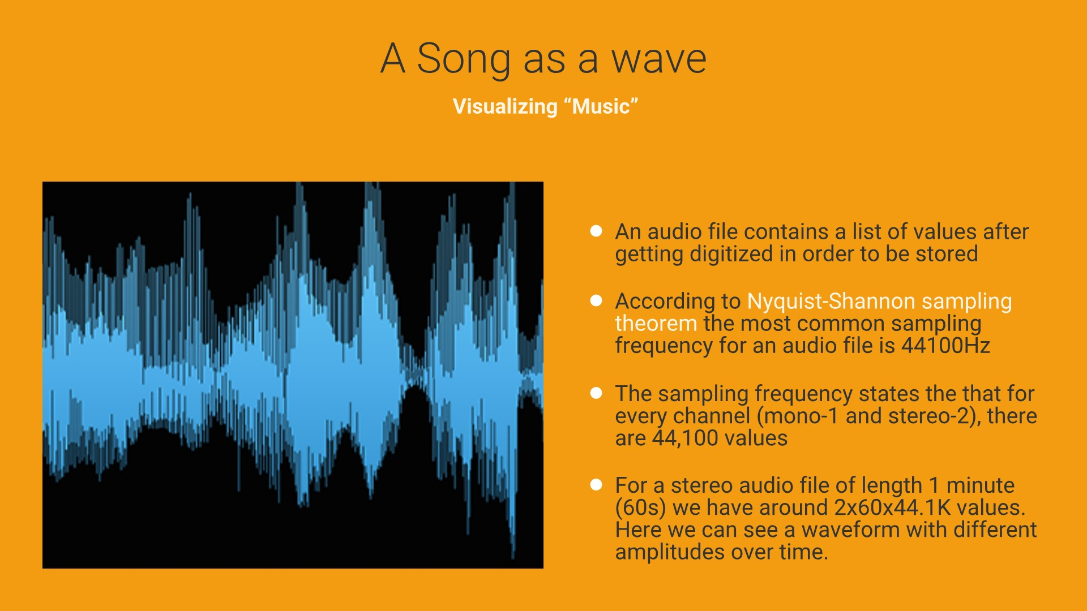
AMPLITUDE x TIME
THE WAVE FORM OF A SONG

Slide 9
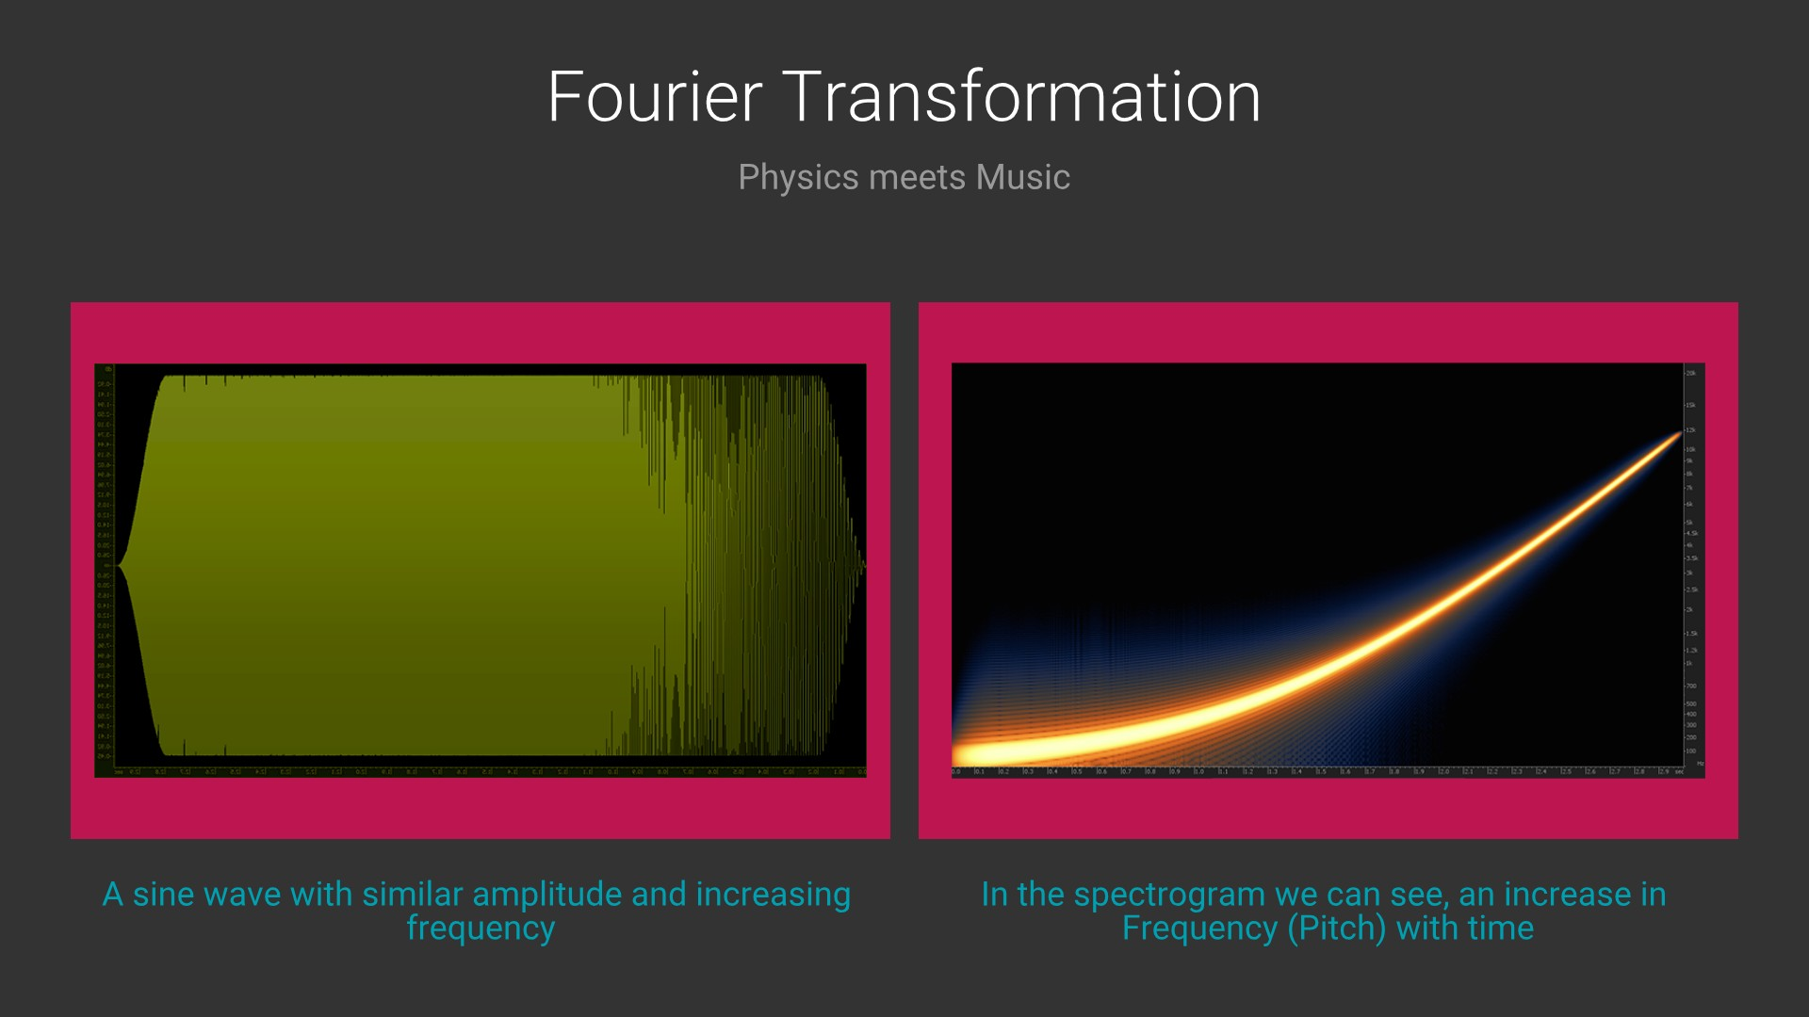
FFT

Slide 10
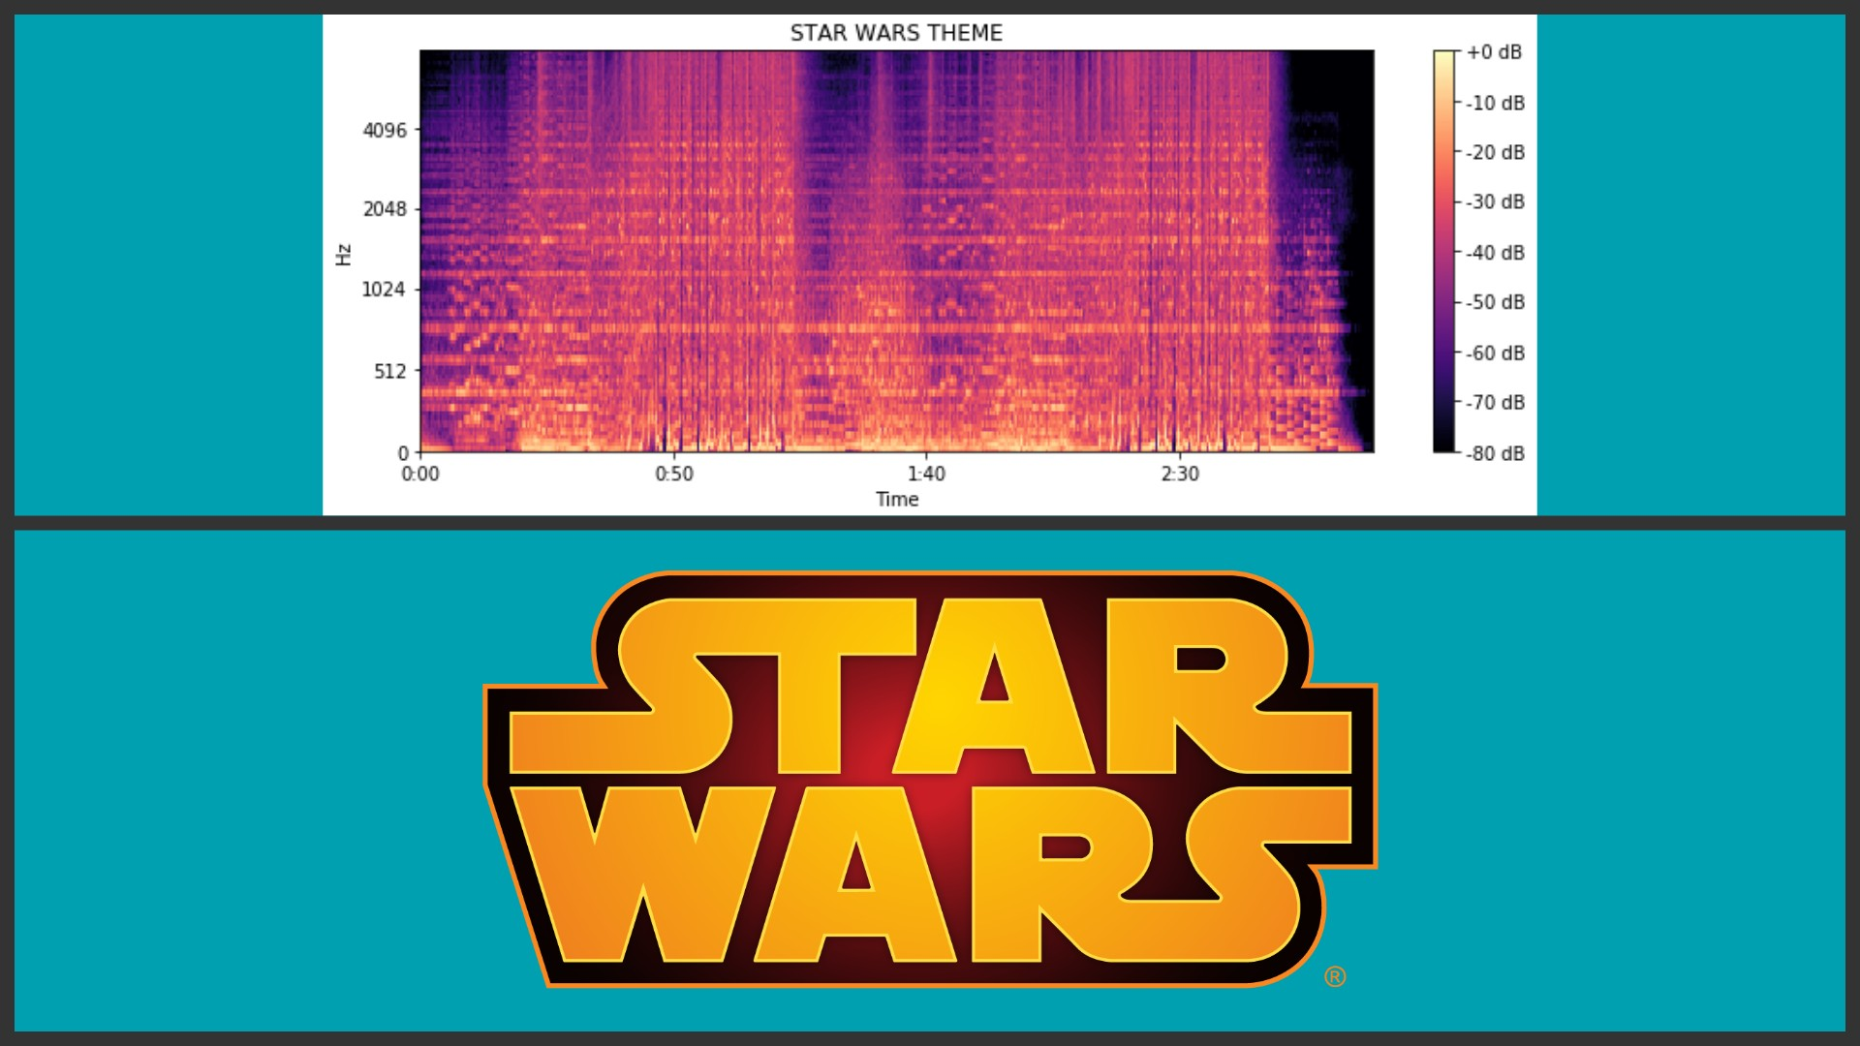
FULL
SPECTROGRAM

Slide 11
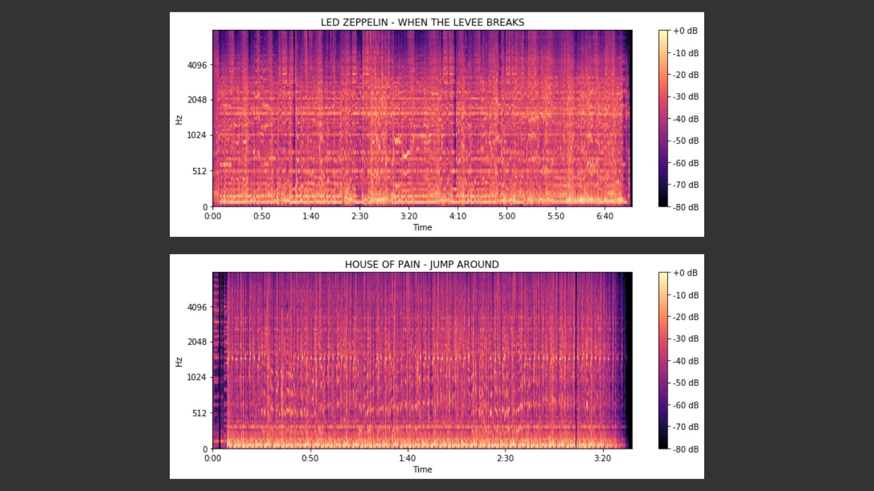
ROCK
DIFFERENT!
HIP-HOP

Slide 12


Slide 13
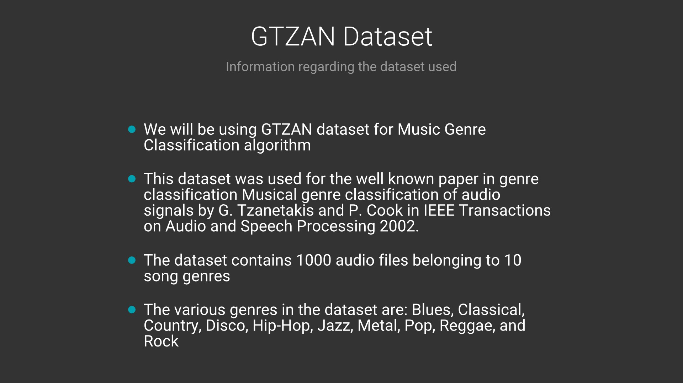

Slide 14
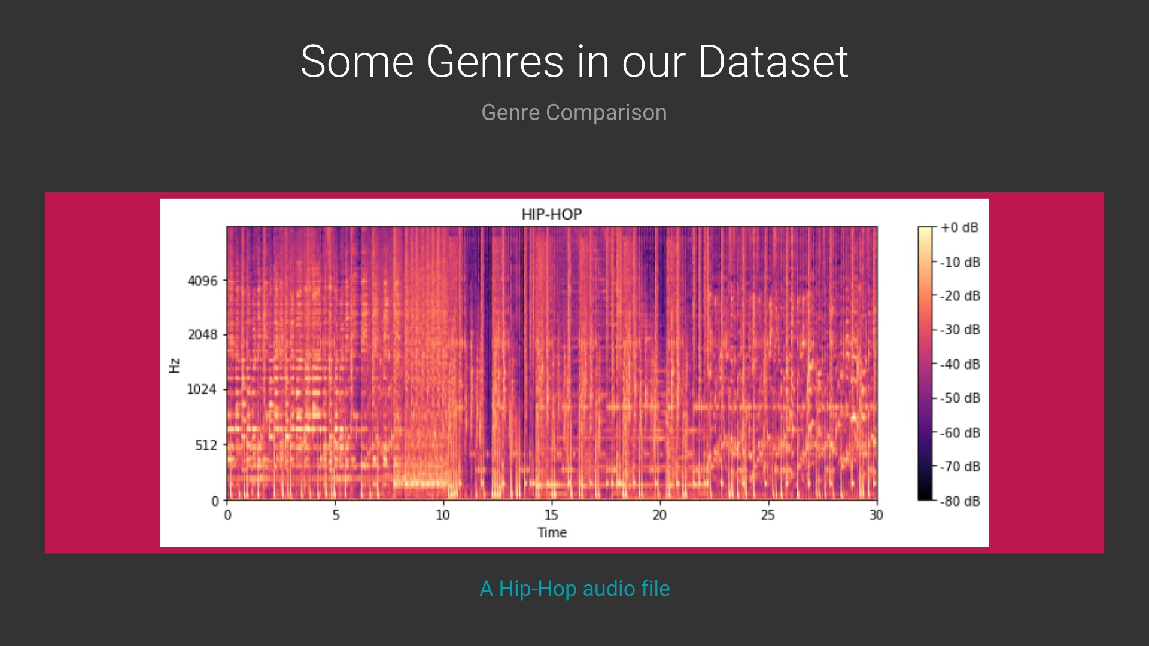

Slide 15
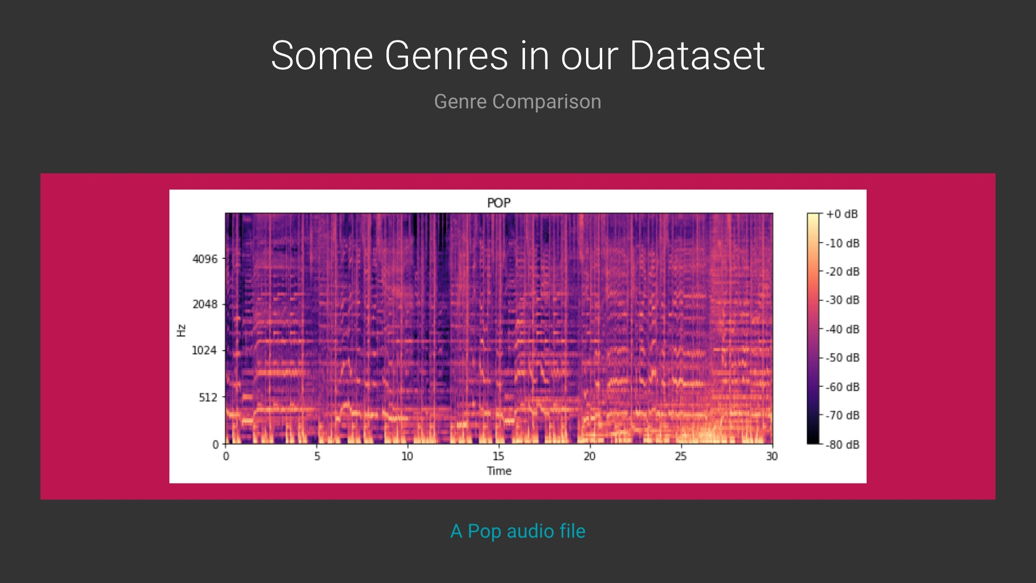

Slide 16
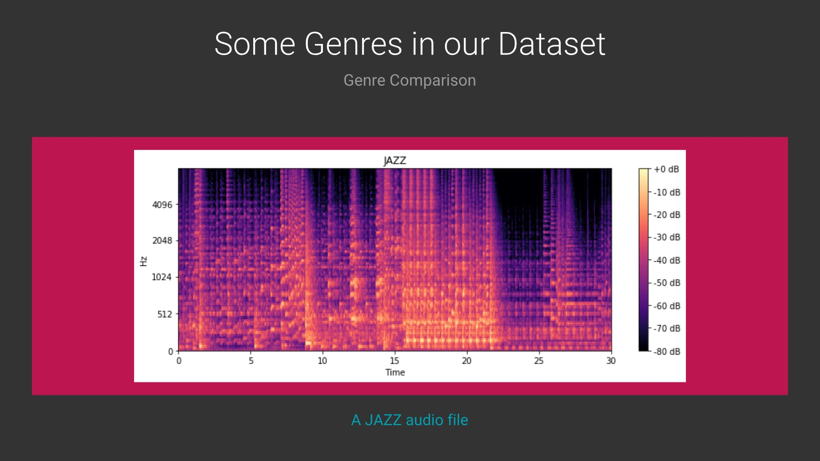

Slide 17
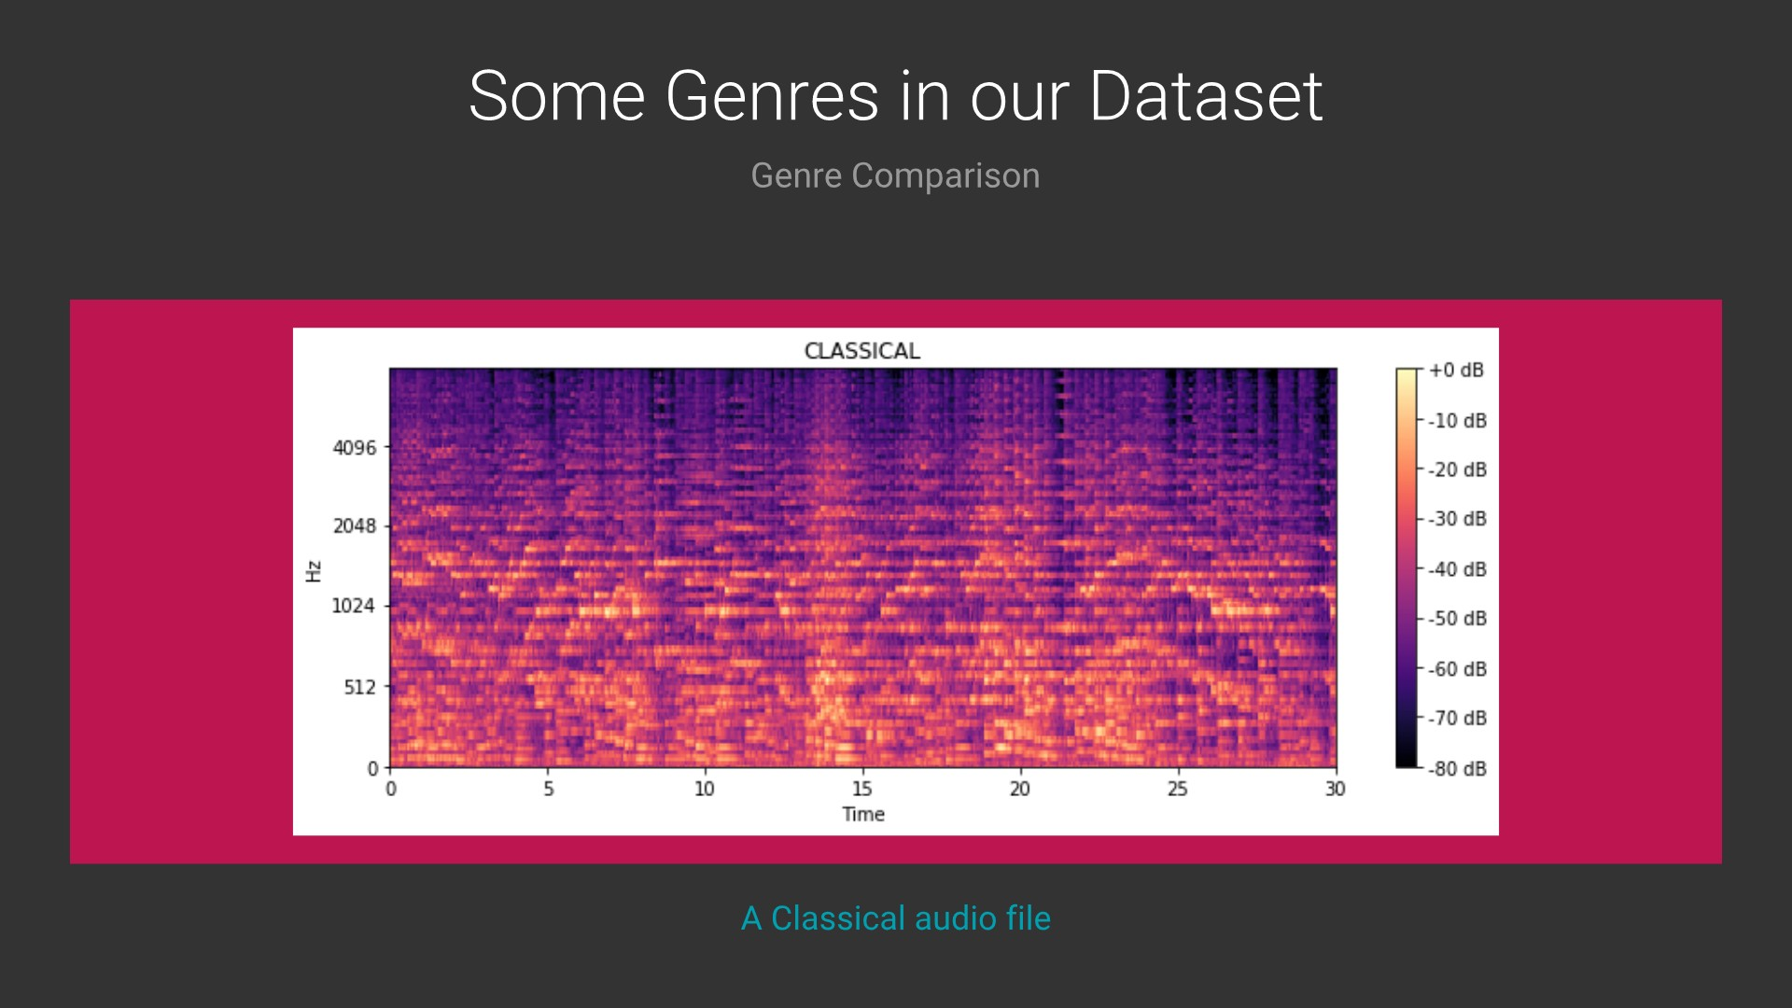

Slide 18
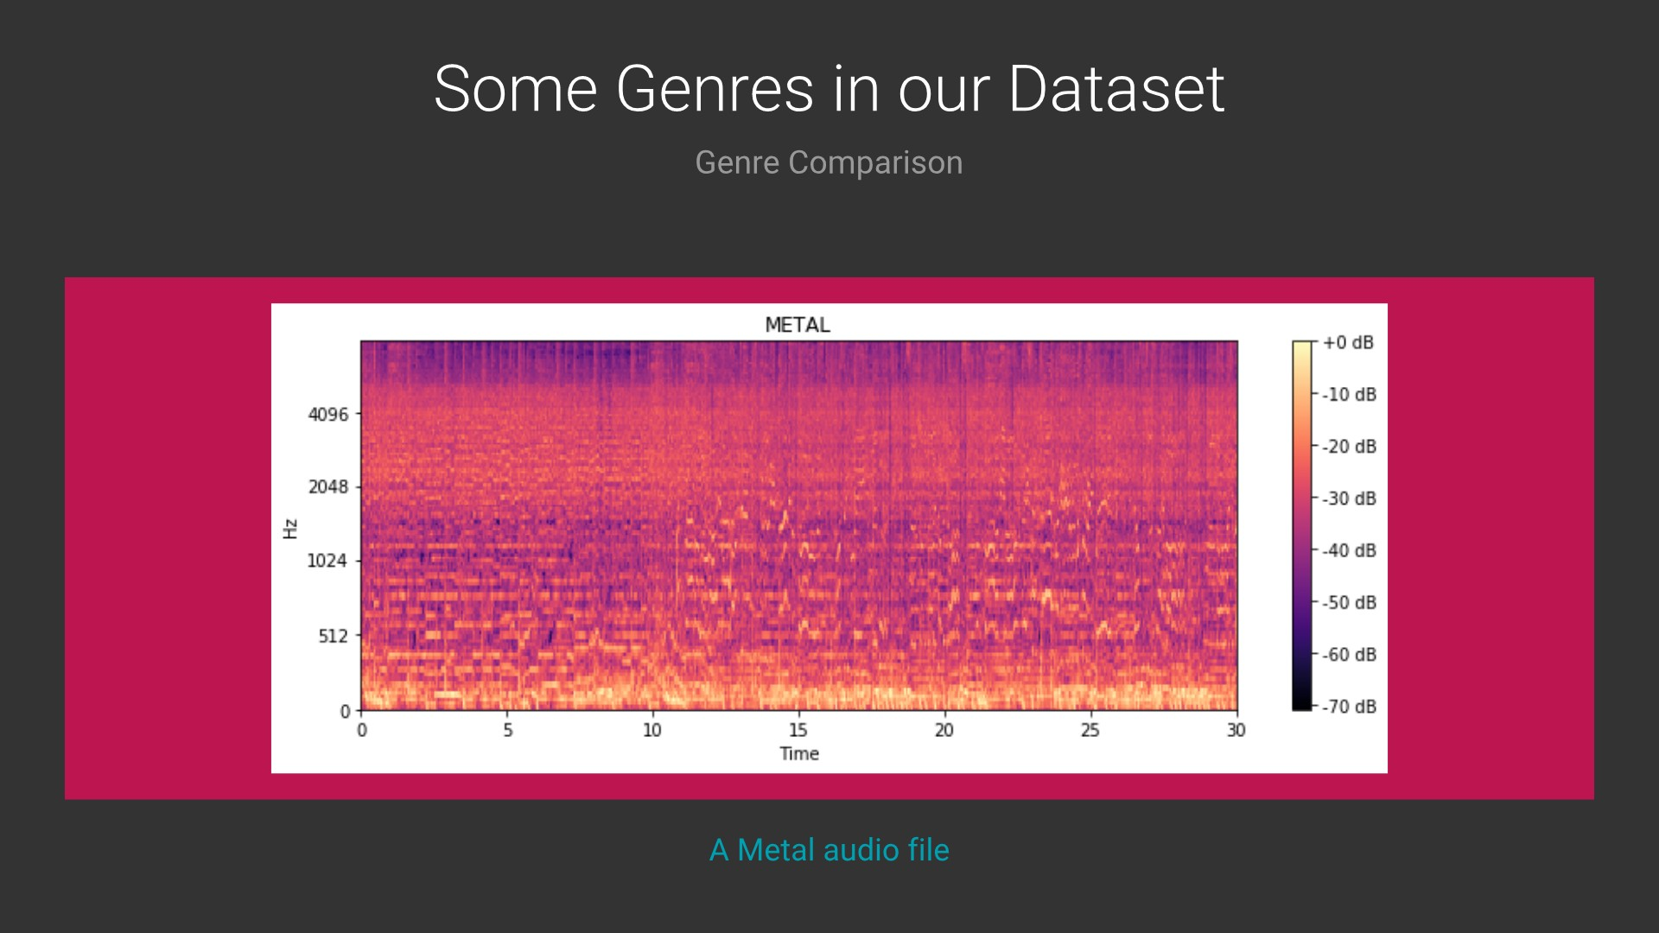

Slide 19
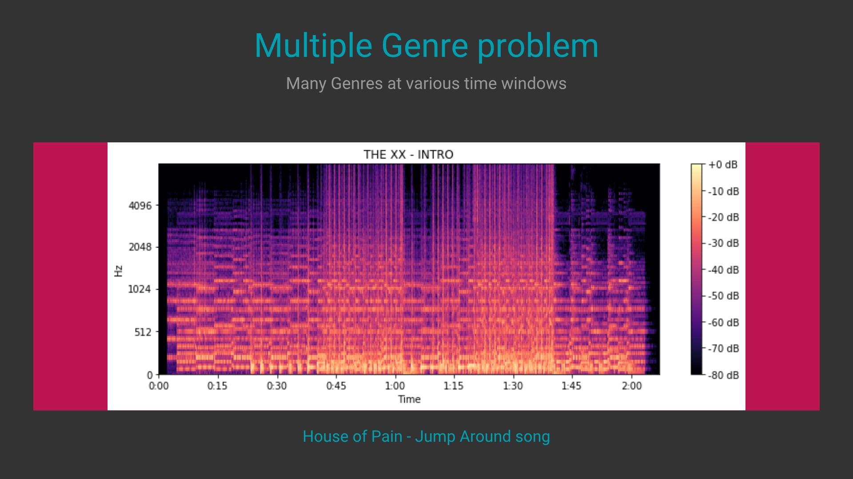
JAZZ
ELECTRONIC

Slide 20
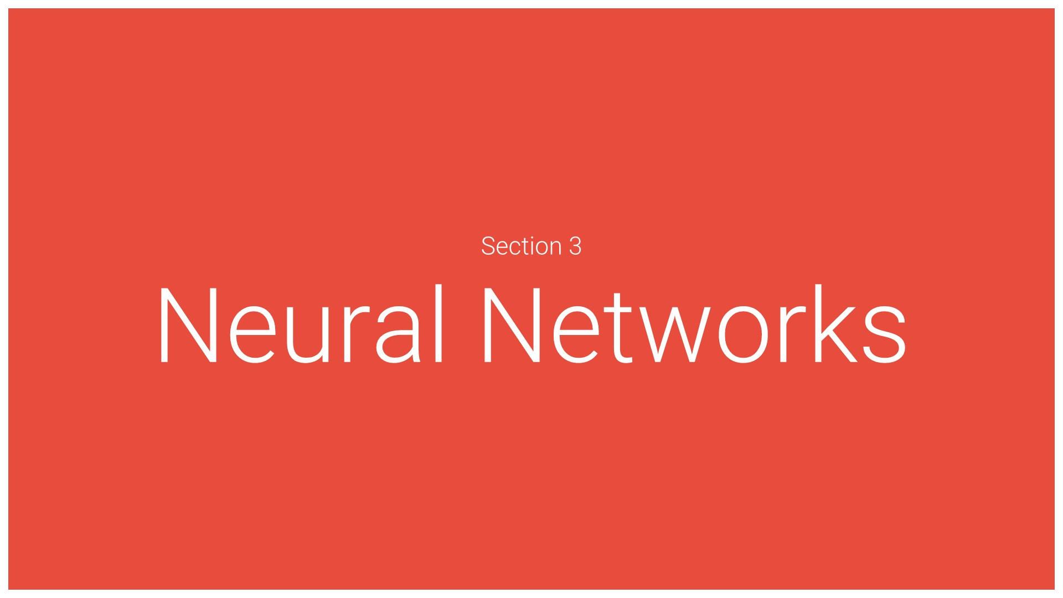

Slide 21

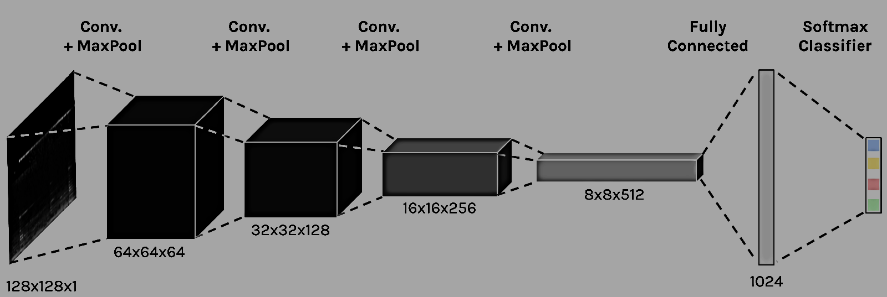
CNN ARCHITETURE

Slide 22
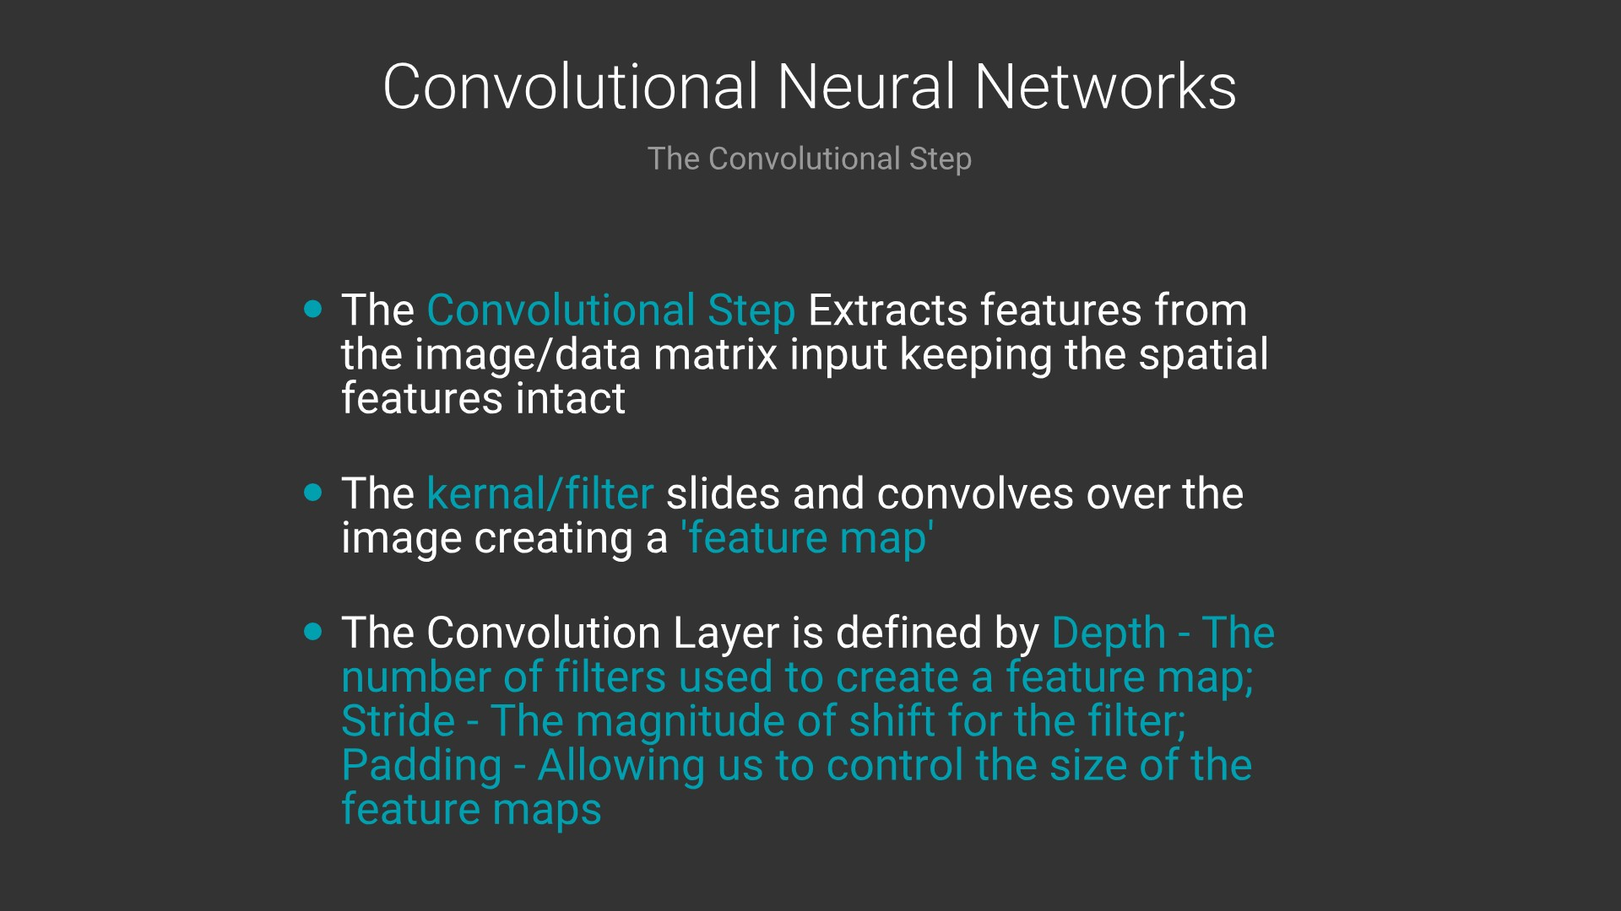

Slide 23
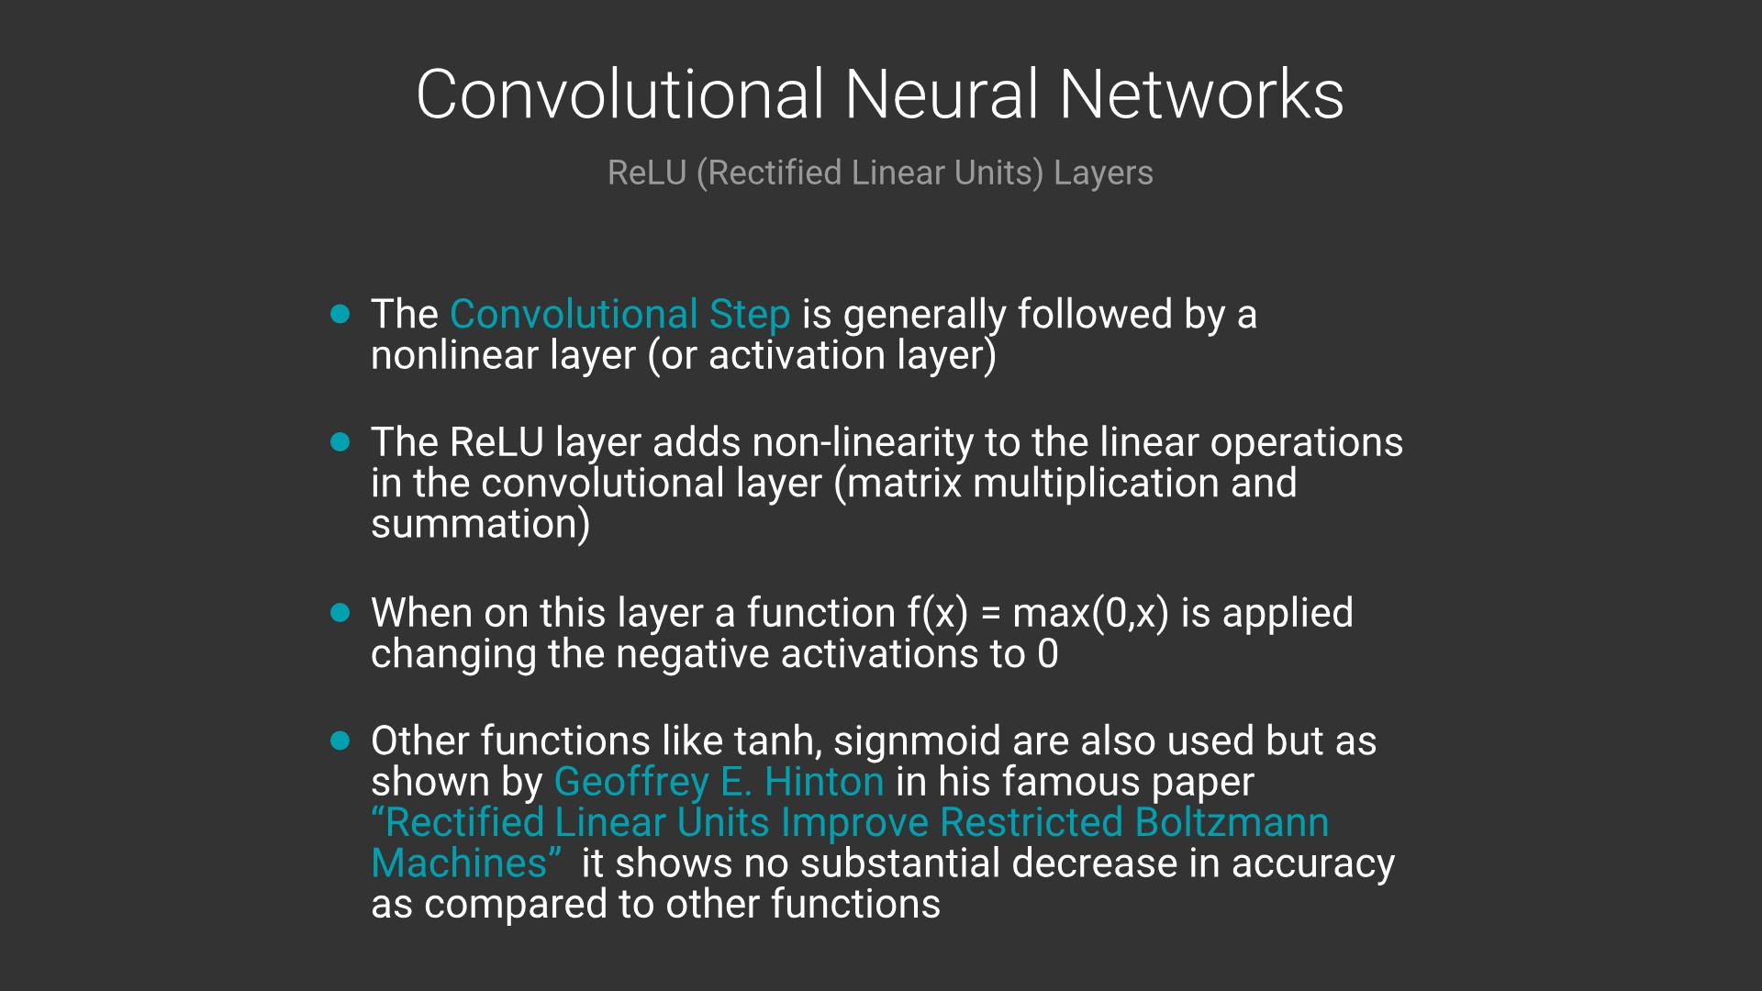

Slide 24
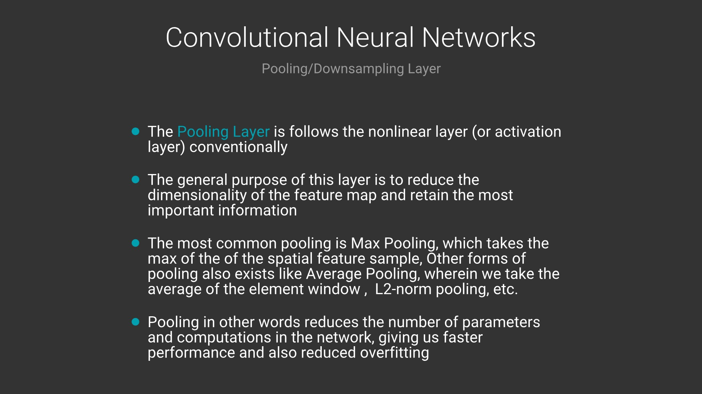

Slide 25
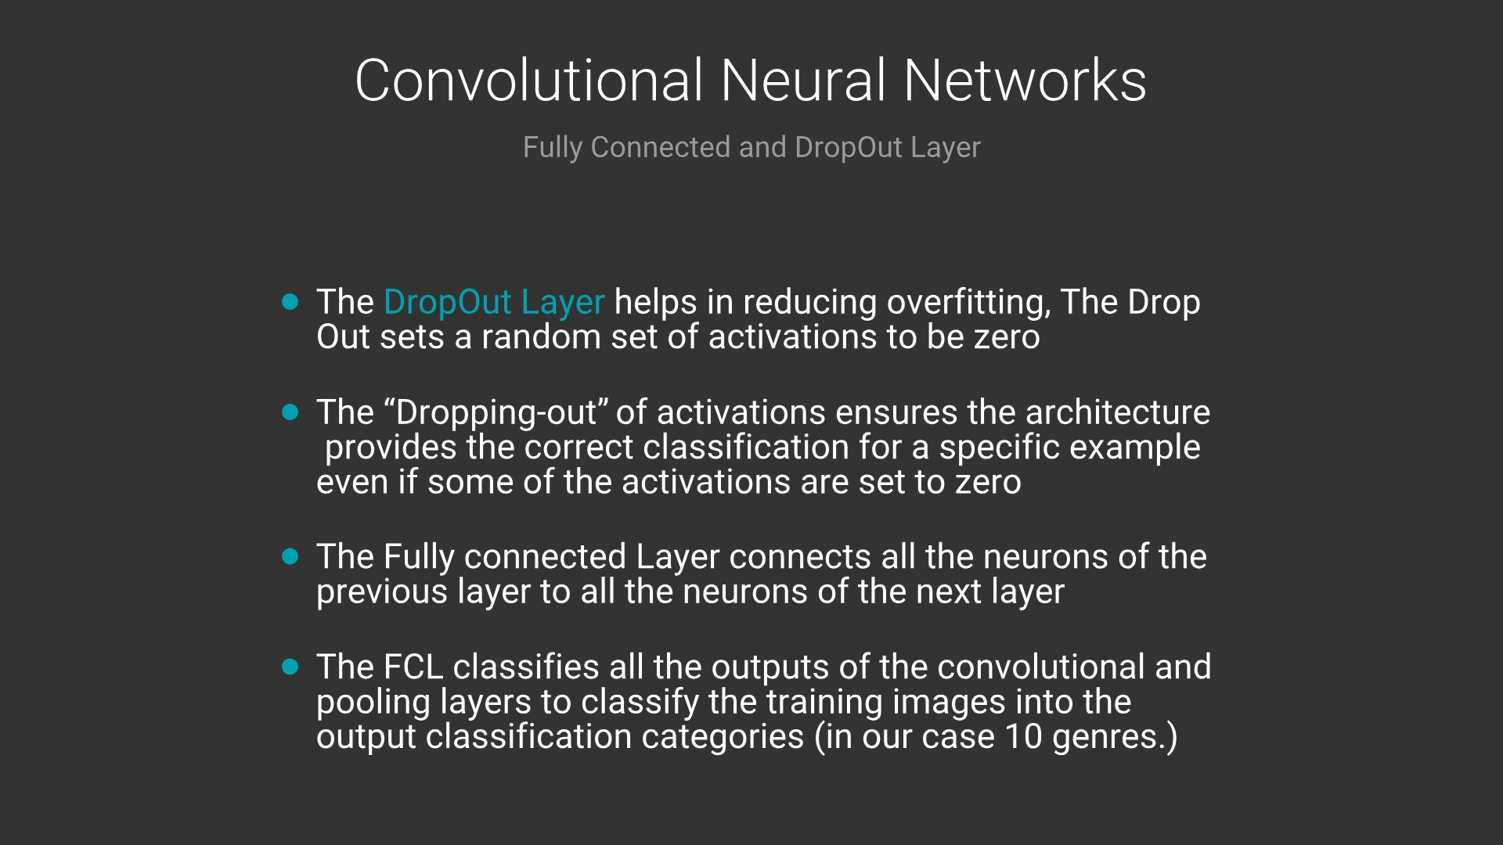

Slide 26
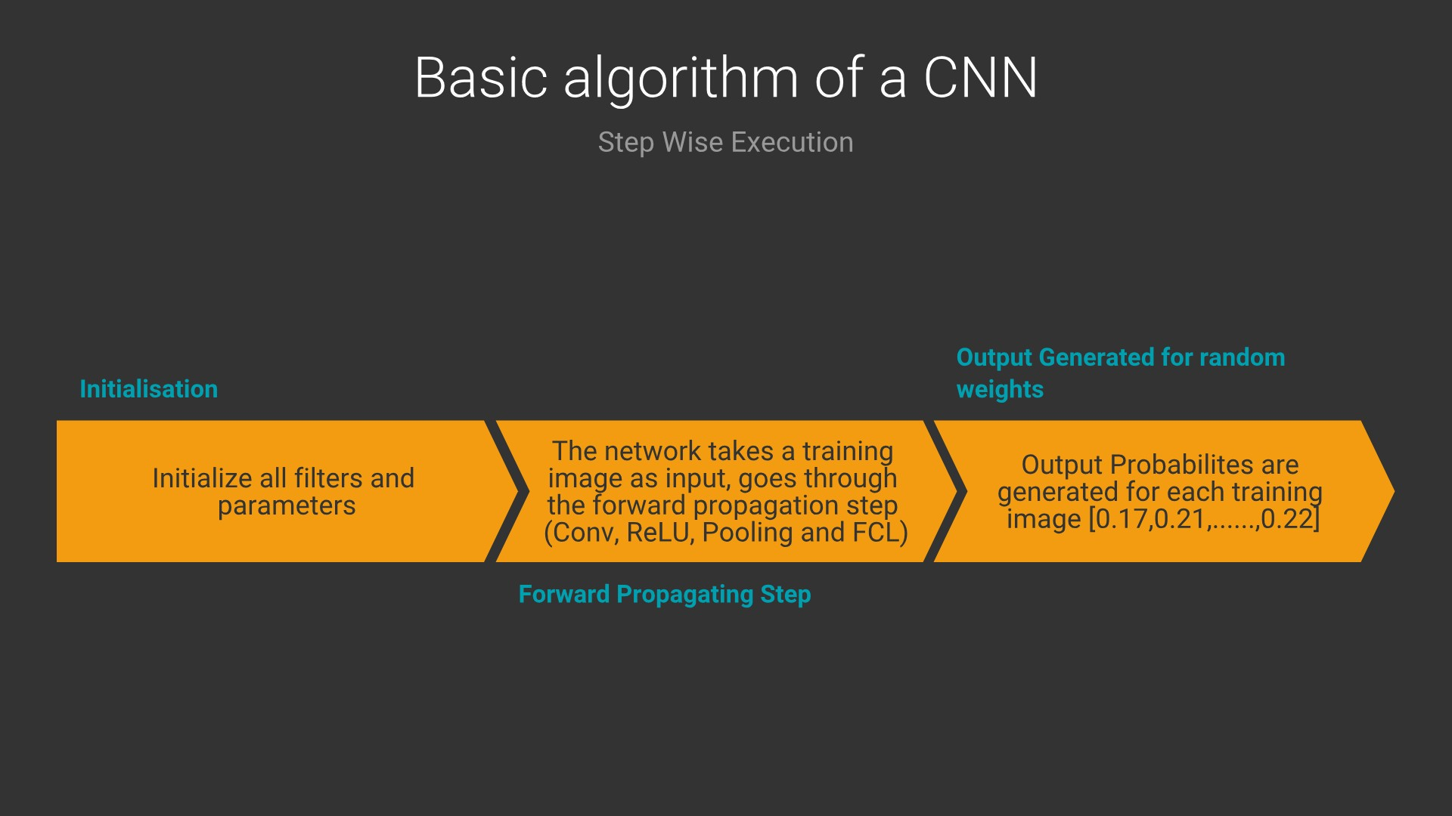

Slide 27
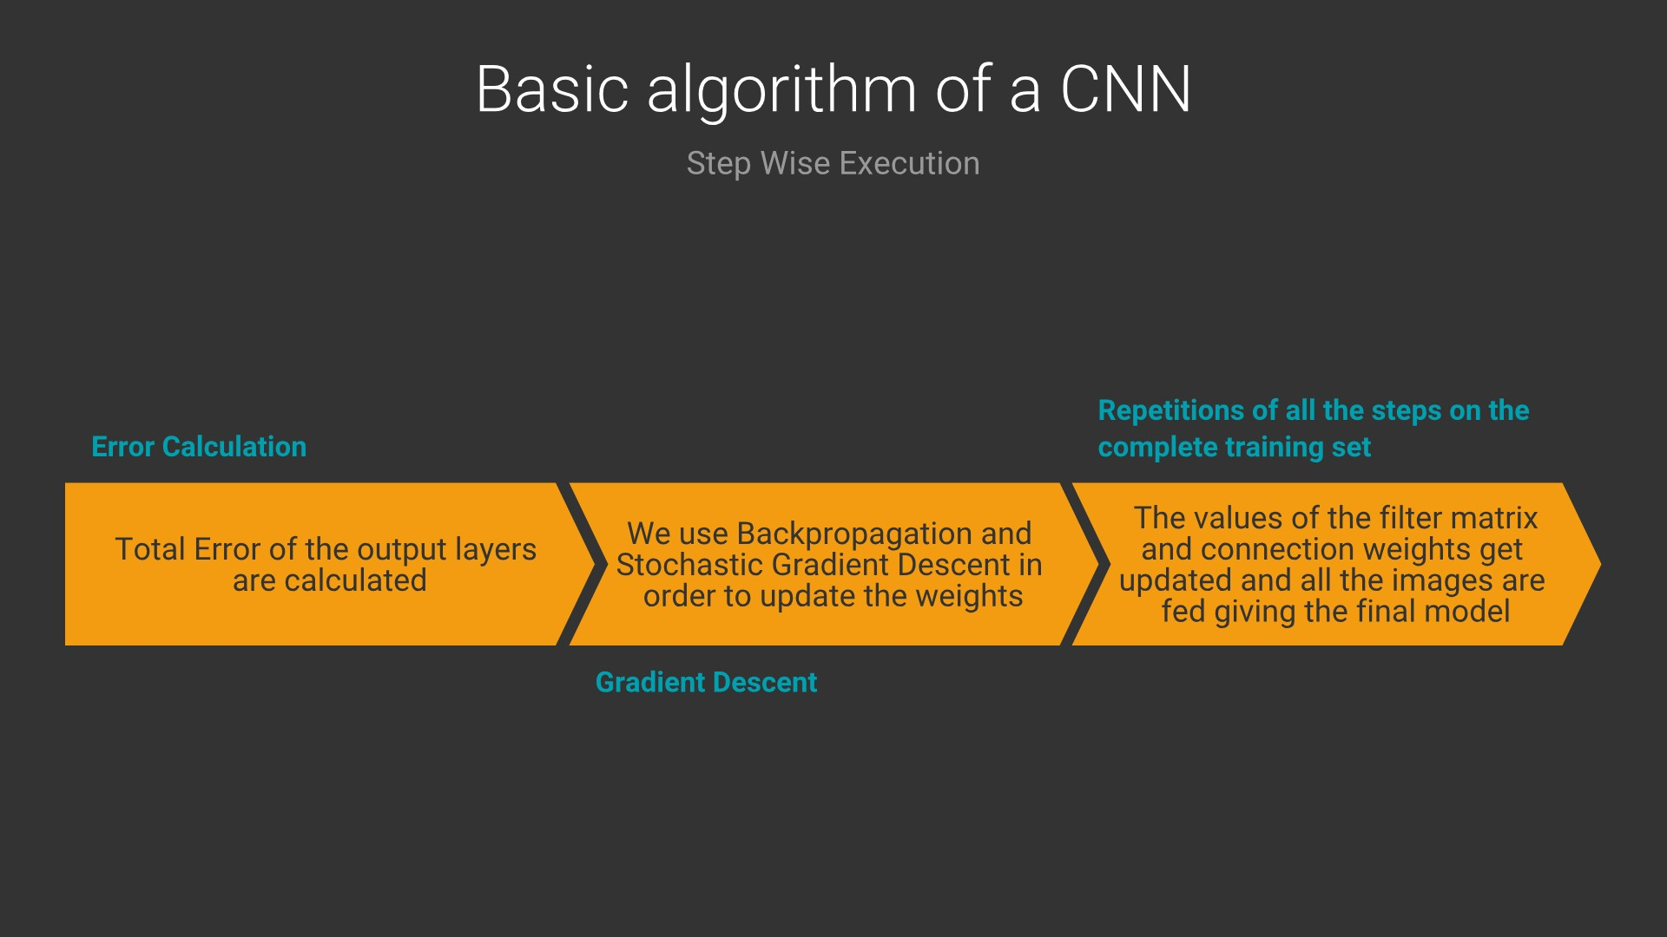

Slide 28
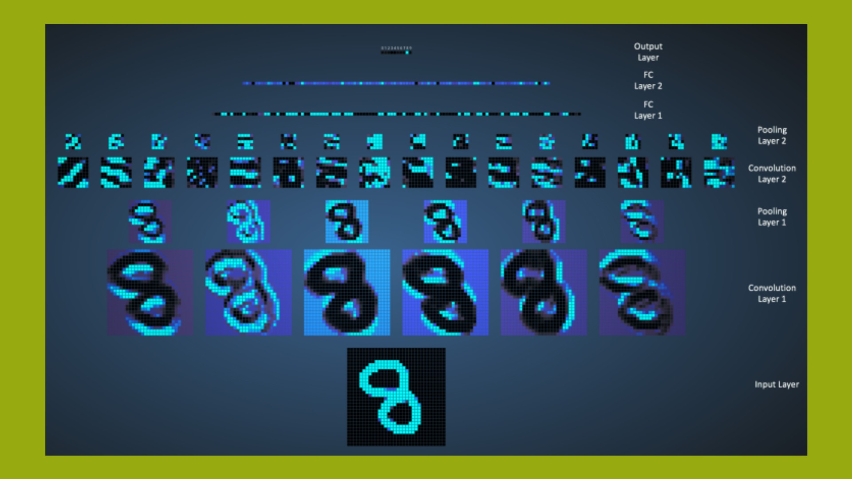

Slide 29
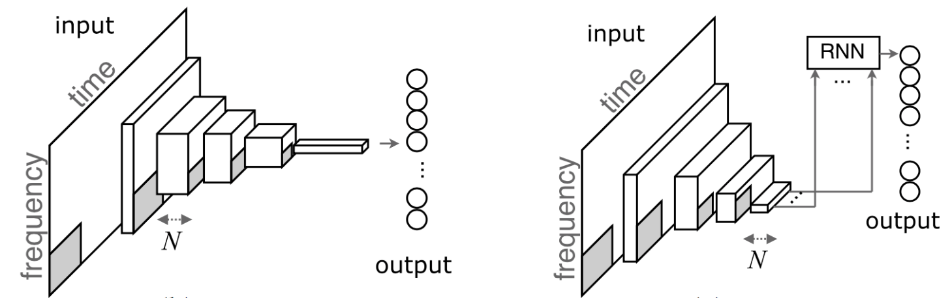

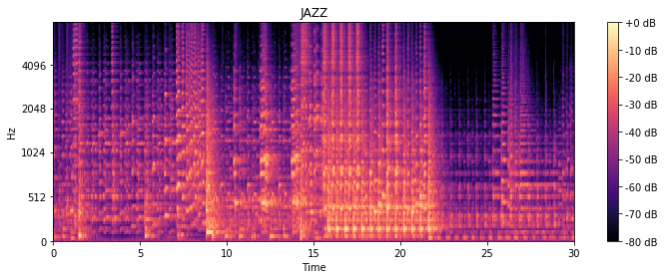
CNN ARCHITETURE INTEGRATION
AUDIO FILE
MEL-SPECTROGRAM
CRNN
VGG-16, VGG-19 (Theano) and ResNet50x (Pytorch)
Automatic tagging using deep convolutional neural networks, Keunwoo Choi, George Fazekas, Mark Sandler (2016)

Slide 30
CRNN ARCHITETURE INTEGRATION
AUDIO FILE
MEL-SPECTROGRAM
CRNN
Modified LetNet, AlexNet, ZF Net and GoogleNet on Theano
Automatic tagging using deep convolutional neural networks, Keunwoo Choi, George Fazekas, Mark Sandler (2016)

Slide 31
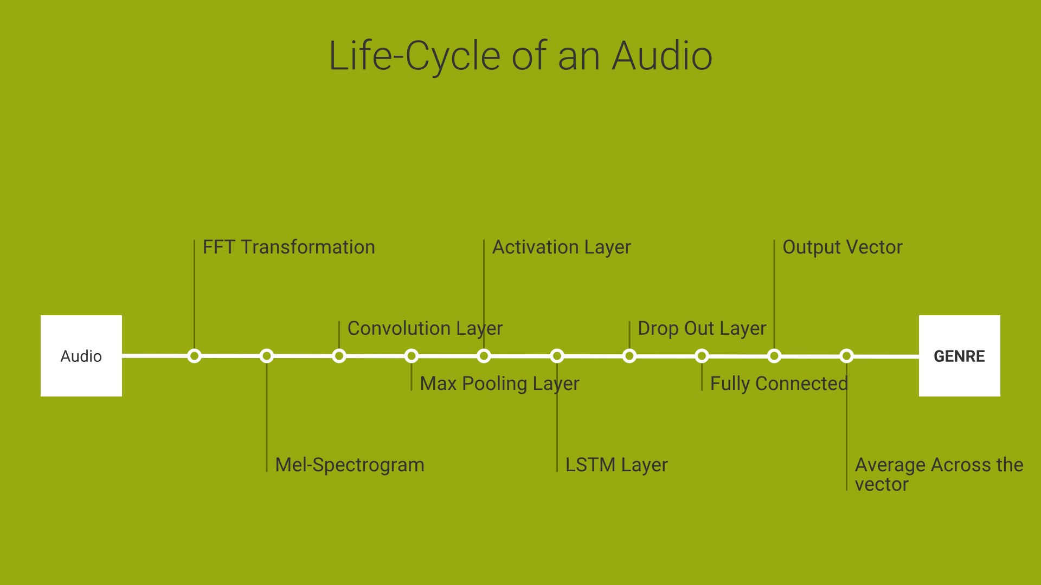
1
5
8
3
6
4
7
2
9

Slide 32

Filters and Learning
What they sound like ?
Layer 1
Layer 2
Layer 3
Electric Guitar
Female Vocal
Male Vocal
Rap
Jazz
Percussion
http://deepsound.io/music_genre_recognition.html

Slide 33
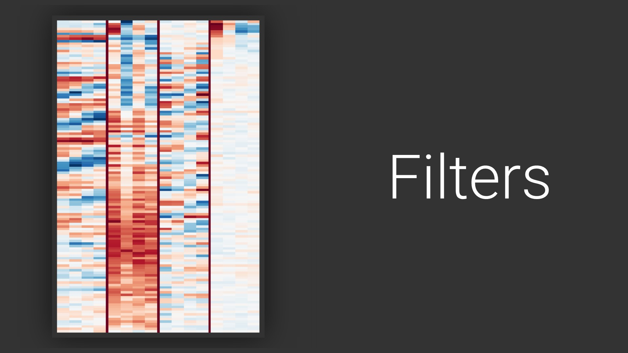
14 – Vibrato Singing
242 – Ringing Ambience
250 – Vocal Thirds
253 – Bass Drum Sounds
14
242
250
253
http://benanne.github.io/2014/08/05/spotify-cnns.html (2014)

Slide 34


Slide 35
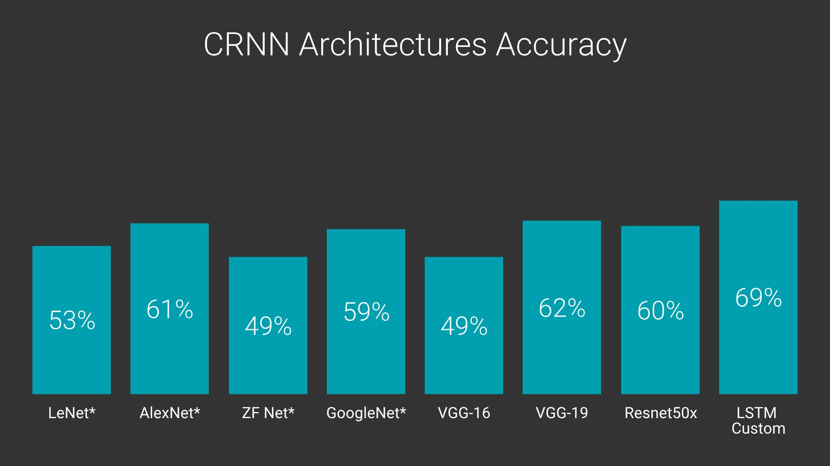

Slide 36

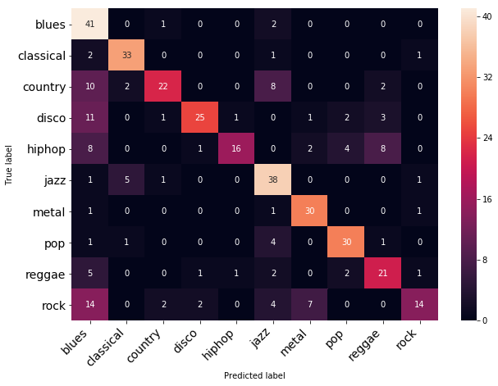
CONFUSION MATRIX FOR LSTM Custom
~ 68.5% Accuracy

Slide 37
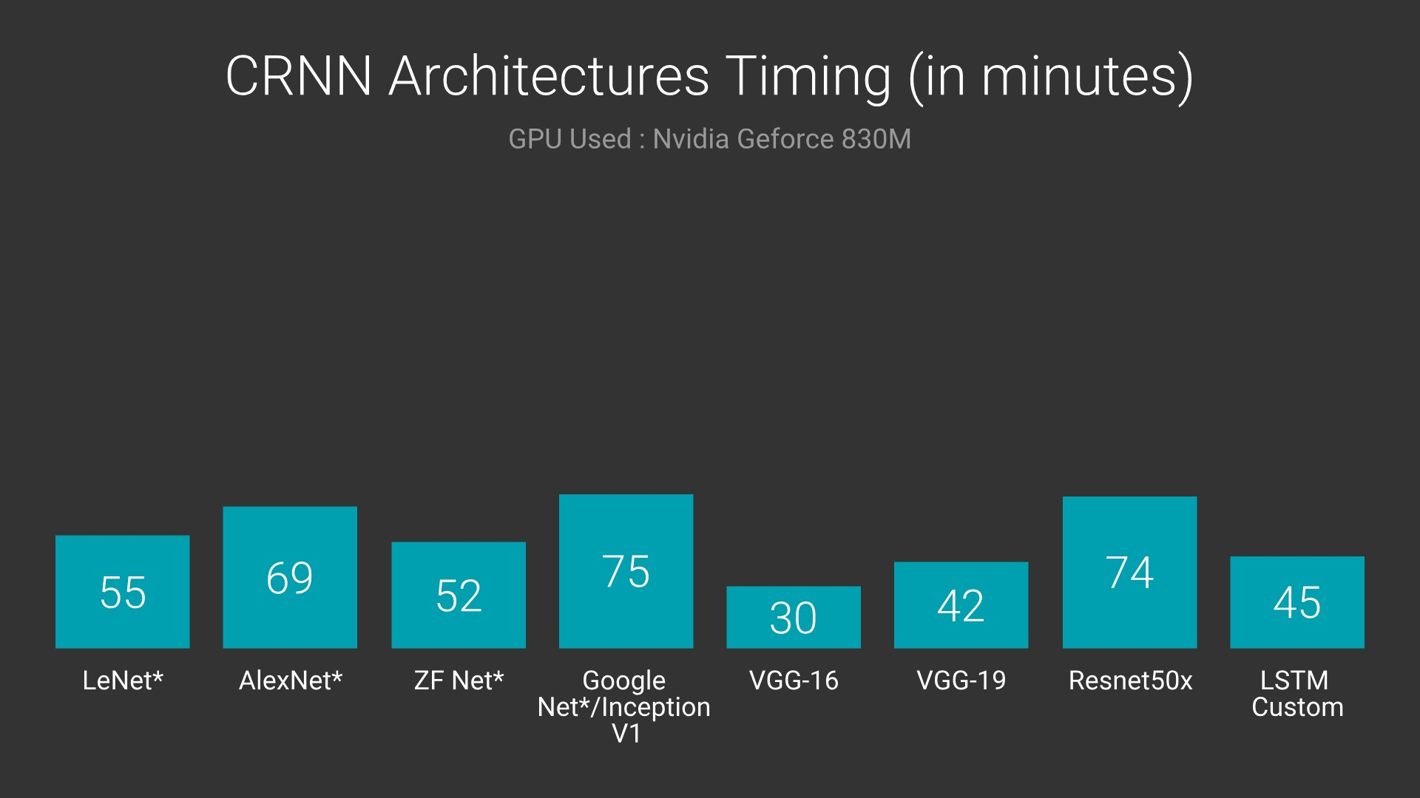
Keras + Theano on Spectrograms
PyTorch on Spectrograms
Keras + Theano on pickle data

Slide 38
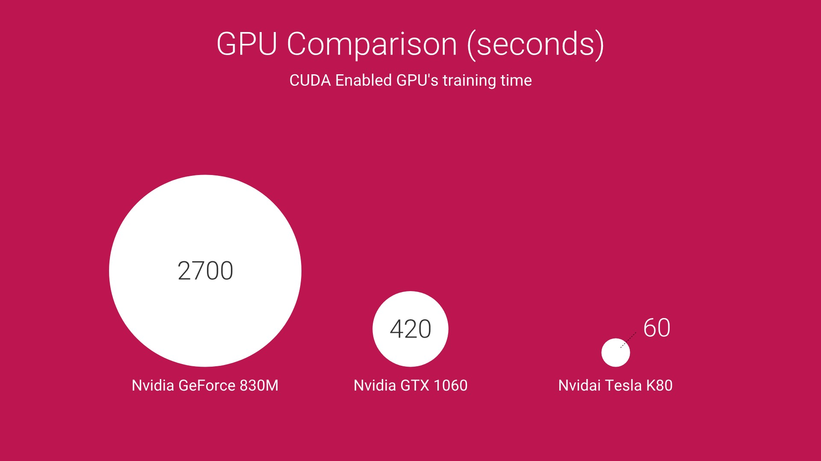


Slide 39
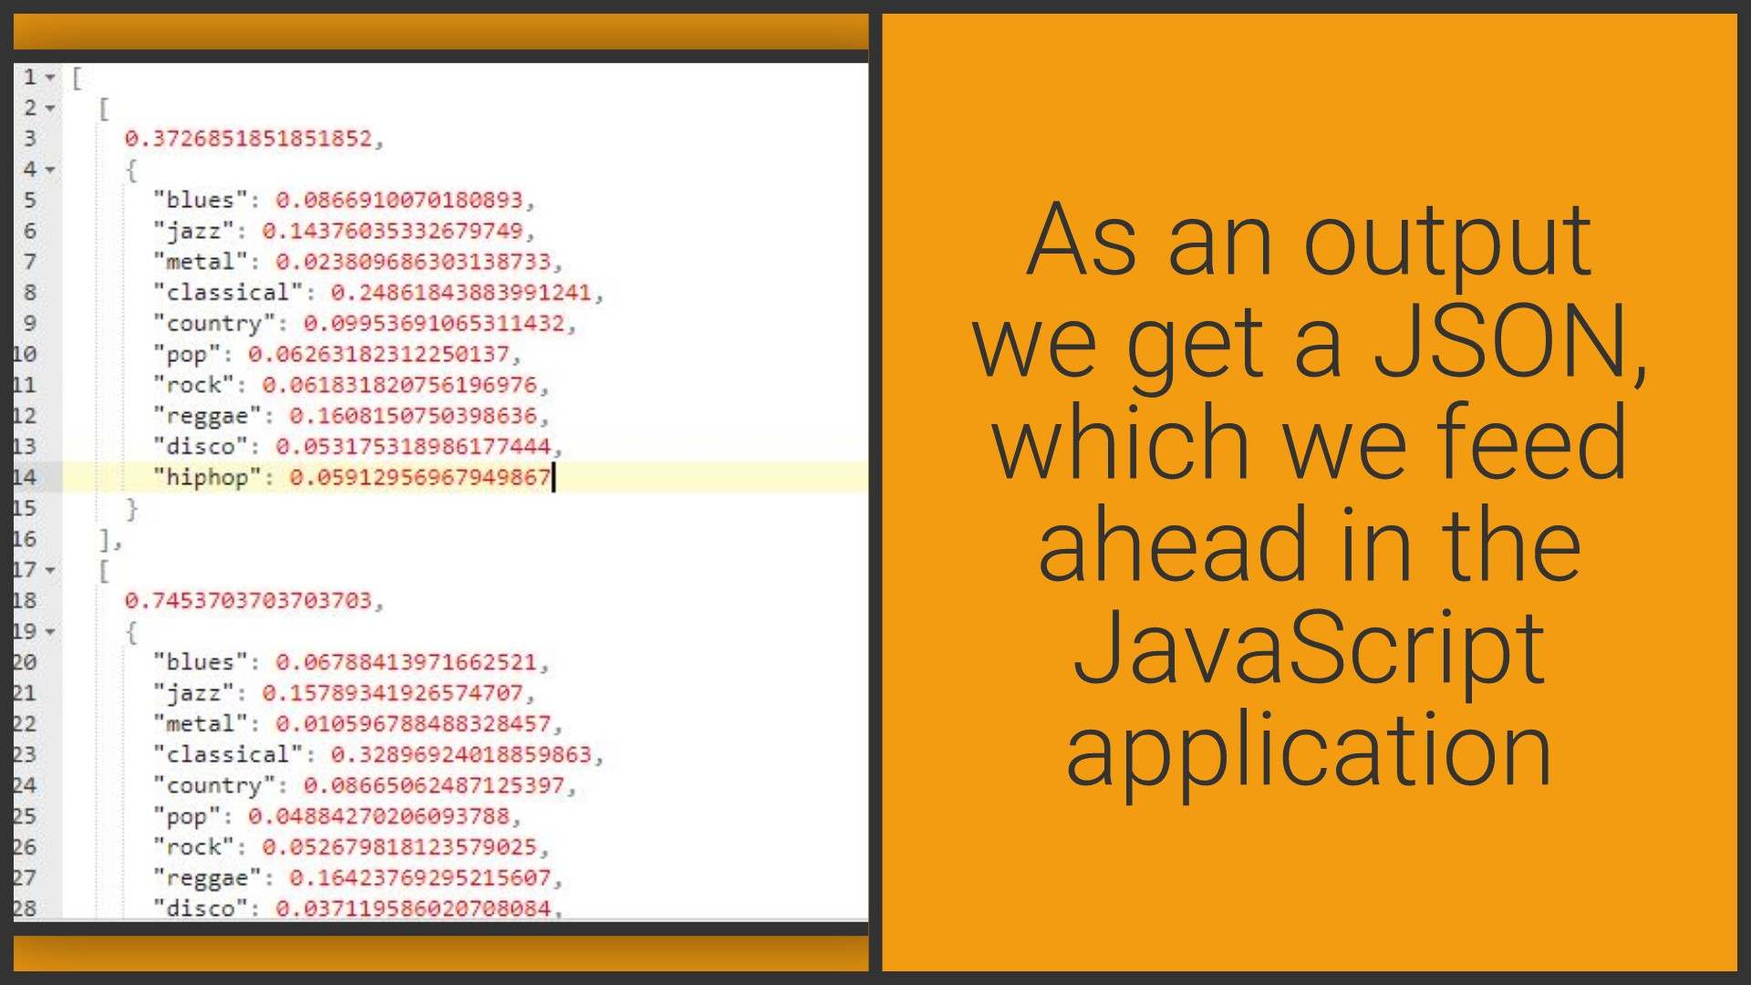

Slide 40
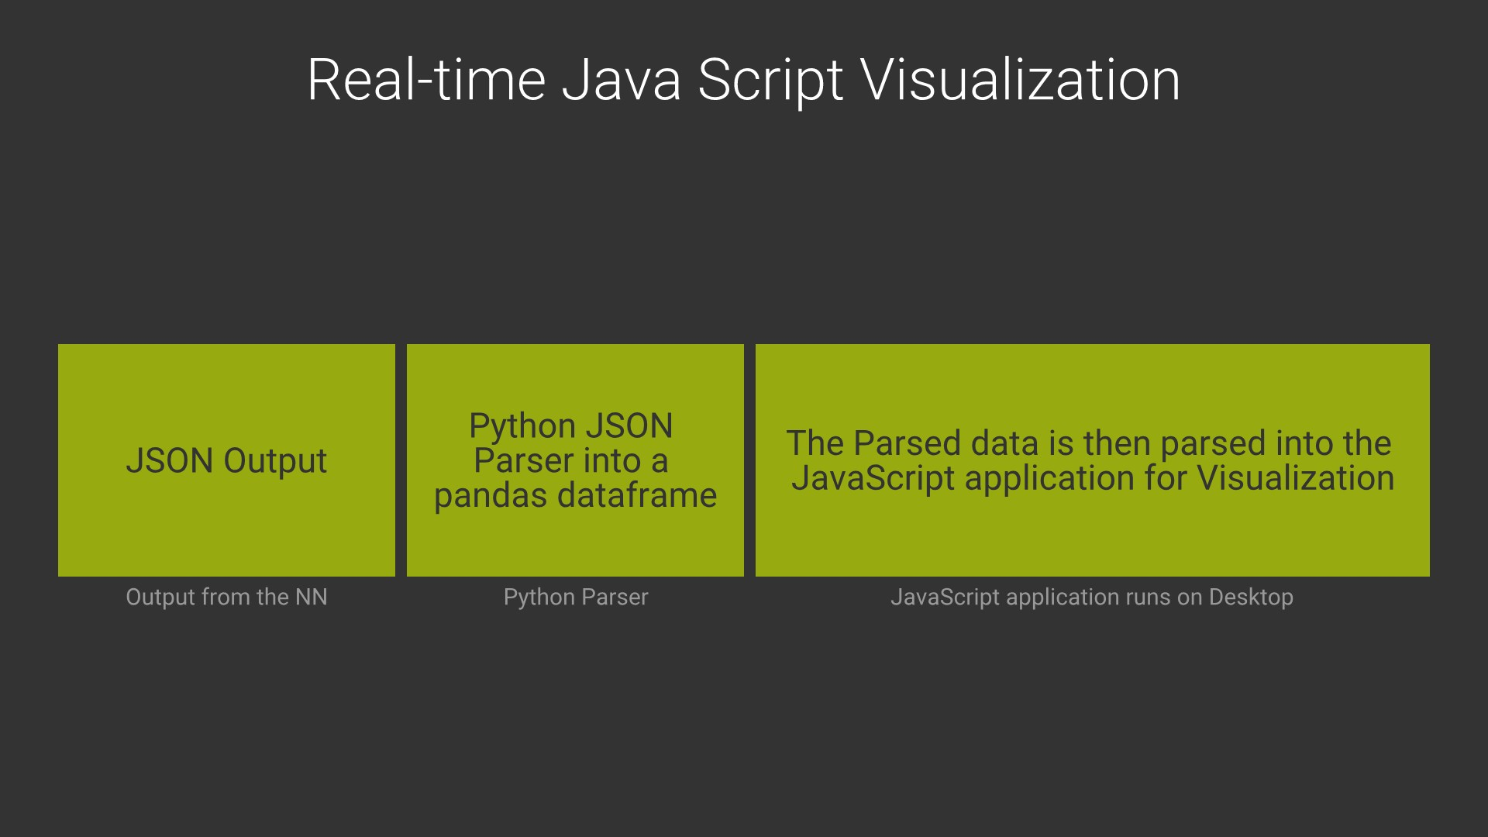

Slide 41
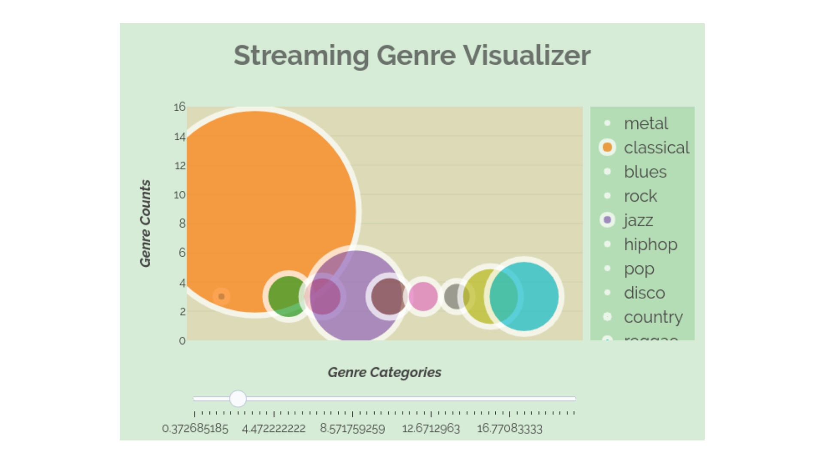
Link to Graph

Slide 42
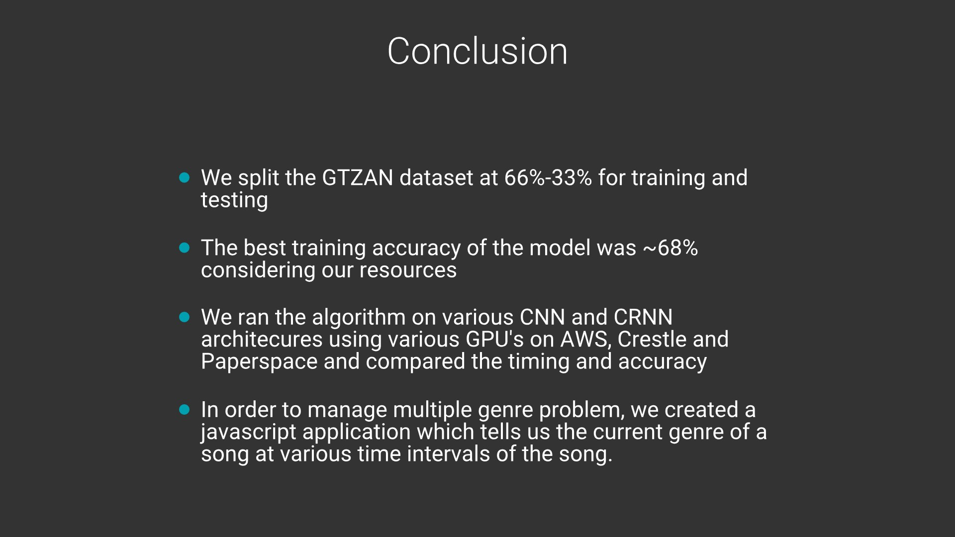

Slide 43
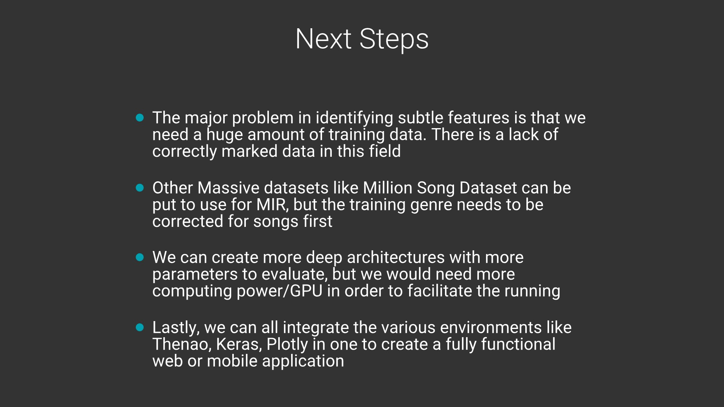

Slide 44


